Slide 1
CLAUSENTUM FEN CONSERVATION GROUP
CHAIR’S REPORT
AGM 18 FEBRUARY 2018

Slide 2
Thank You for practical assistance:
Mike Gibbons started the whole project off
Hugh Corry surveys and initial advice
CFCG website & Instagram – Sleath family
Volunteers from bamboo to replanting trees
Fellow officers of the CFCG in 2017
SDNP - Ranger Rob Nicholls, Water vole team
Andrew Scott – water engineering expertise
Nick Radford – Natural England experience
TCV Ranger - Rachel Bryan
HCC Rangers - Pete Durnell, Steve Ord & Matthew Heaver
PSFFA/Test & Itchen Association - Matt Owen-Farmer River Fly Monitoring, Angus Buchanan
Matthew Greening – monthly Riverfly Monitoring
WCC Trees & Landscapes - Stefan Kowalcyzk & Sue Croker
Environment Agency – Lawrence Talks & Judith Beard
Hampshire Biodiversity Records – Nicky Court
Wessex Chalk Streams – Vee Moore & Rupert Kelton
Bishops Waltham North Pond - Barry Jerome
Winchester College River Keeper - Mark Sankey
Natural England – Dr Alex Poynter
Prof Martin Burton – water engineering expertise
Tim Walker – moth surveys
Hampshire Bat recorder – Nik Knight
TARCA bioblitz team – led by Graeme Davis
Nick Horn energy and tree & channel expertise
Metal detectors – Mark Spinney & Chris Moss
Hampshire Watercourse Consent – Paul Prowting
Approximately 30 experts have helped us in 2017

Slide 3
Thank You for financial support:
£1,000 County Councillor Fiona Mather
£1,000 County Councillor Dom Hiscock
£ 500 TCV Chestnut Fund
£ 500 WCC Town Forum
£2,000 South Downs National Park Authority
£1,500 WINnovations / Community First Dragon's Den
£1,050 Personal donations from the community
£7,550 Sub Total
£ 430 Gifts in kind from the community
e£ 400 Shrub whips from TCV Ovo energy
£2,000 Winchester Round Table Bonfire Fund (mid March)

Slide 4
The story so far
Site uncared for, fen overgrown, derelict, dumped on, declining to scrub
Dec 19 2016 - CFCG sparked at post carols party
Jan 22 – consultation with interested residents / owners
Feb 21 – launch AGM with strategic consultation
Mar 18 – community cuts down main bamboo patch
Apr 4 – first draft of Conservation Management plan
May 14 – open day fen tour and strategy review meeting
June 7 – publication of the 2017- 2022 Conservation Management plan
Sept 18 – Nick Horn starts tree, channel & pond work
Nov 6 – Nick reworks the channels and bund

Slide 5
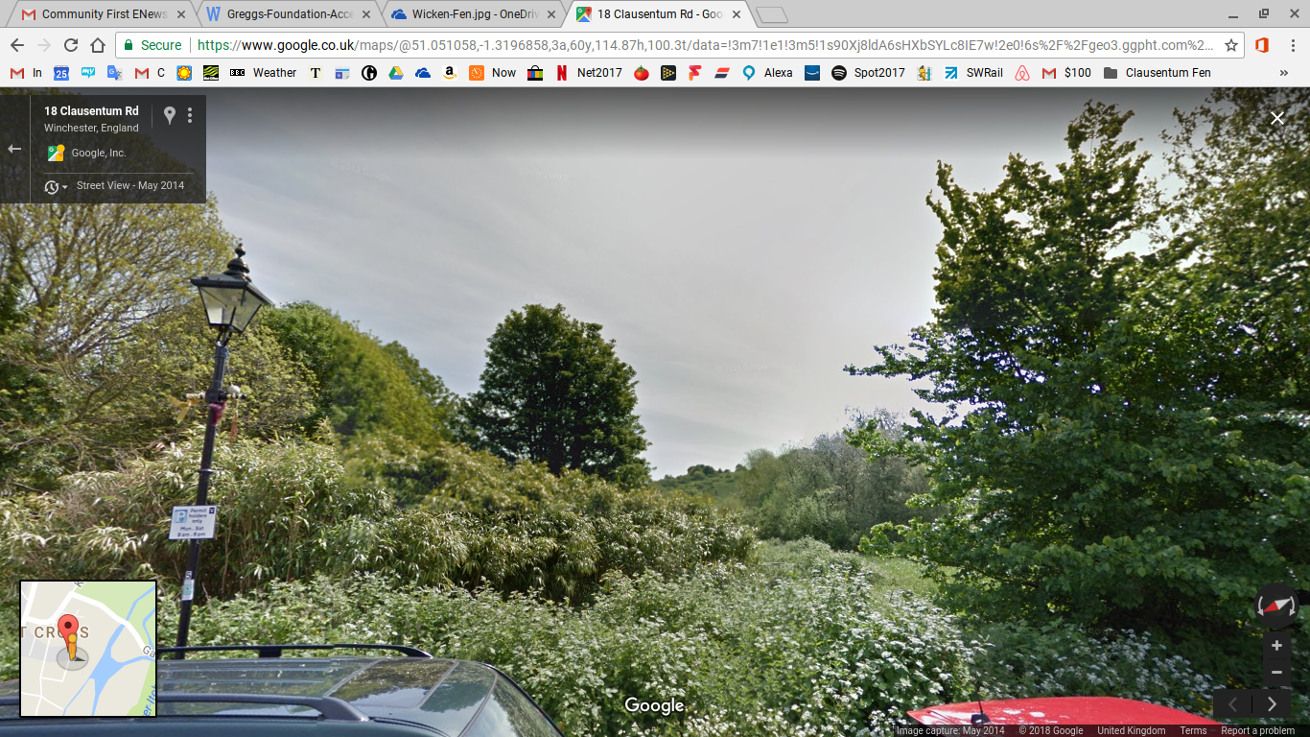
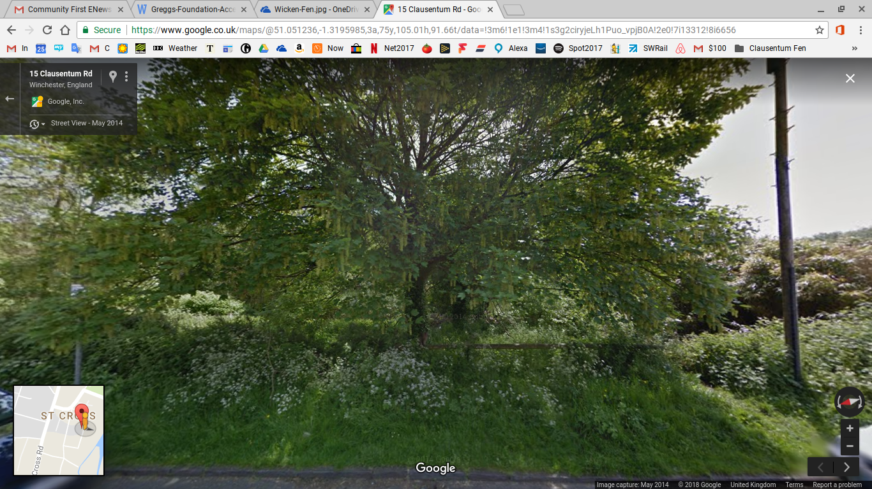
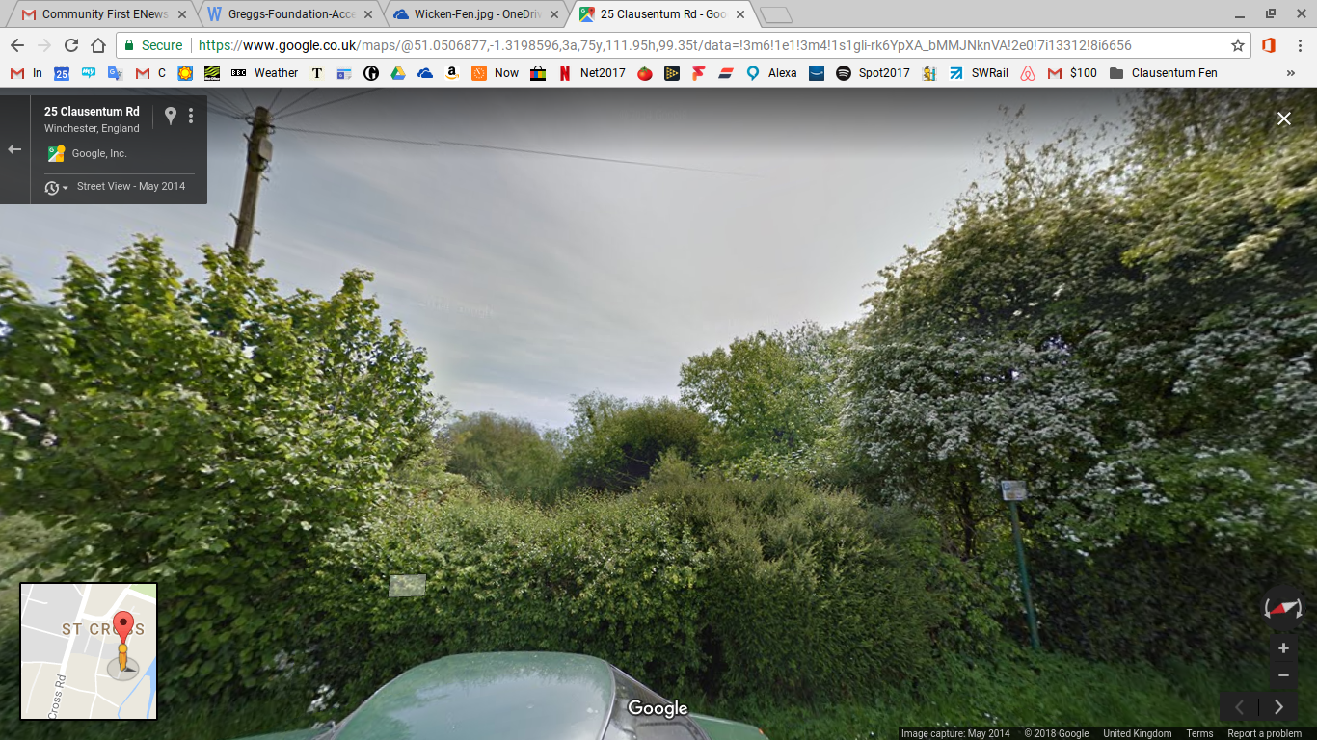
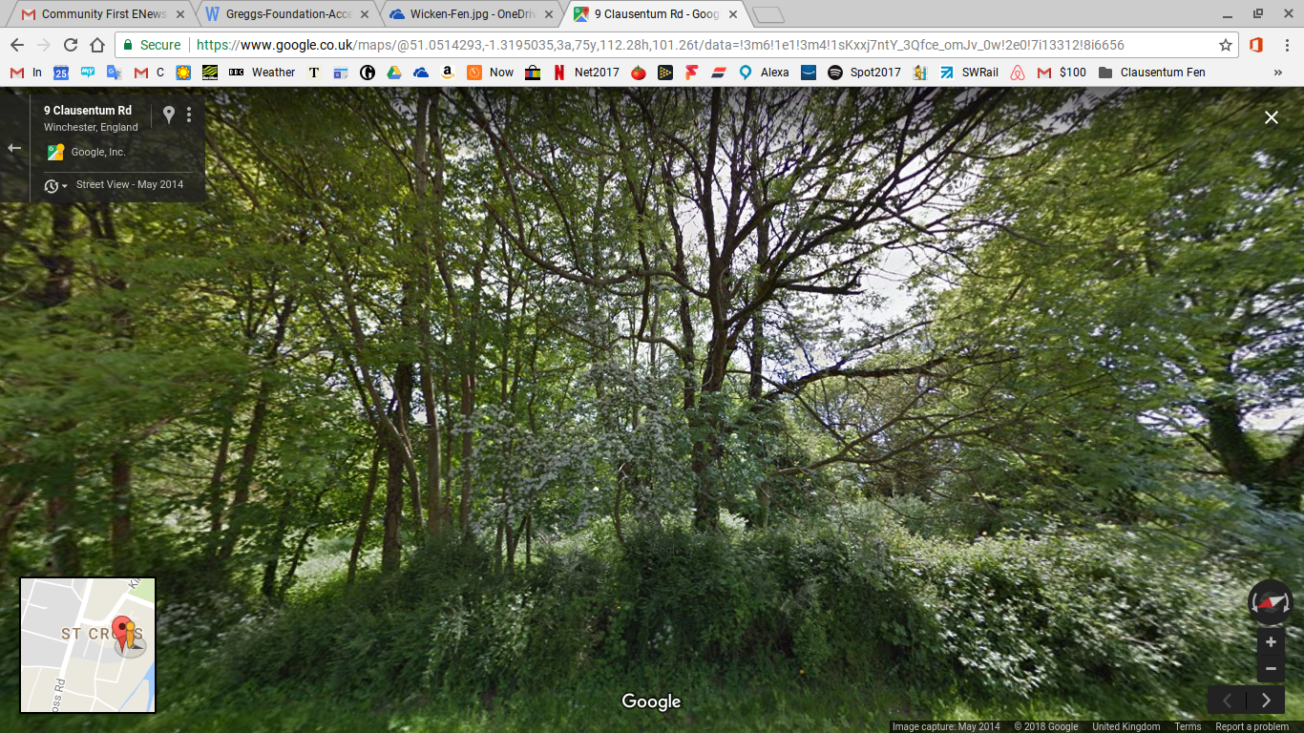
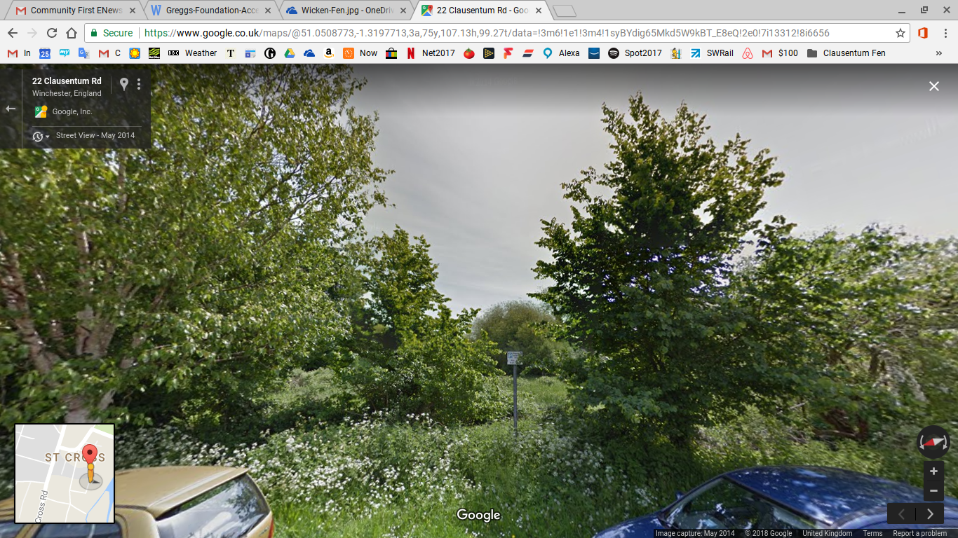
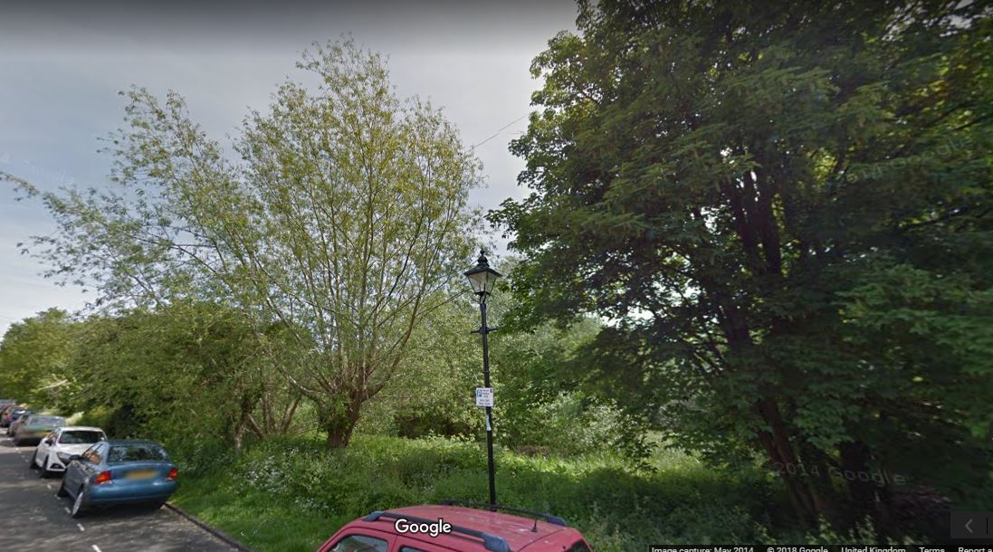

Slide 6
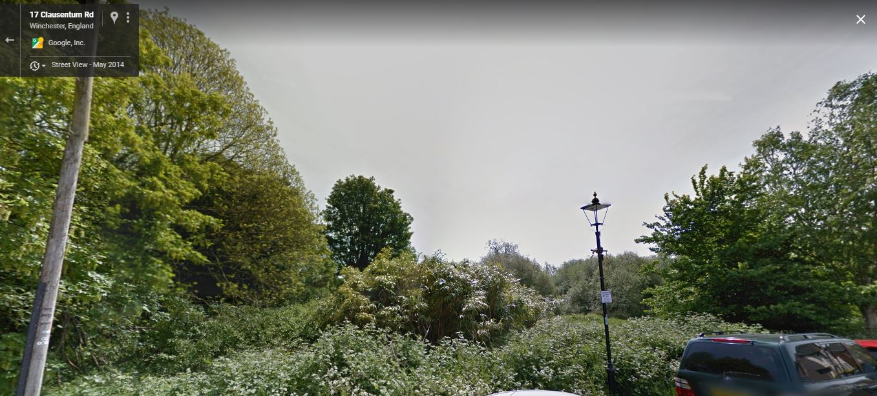
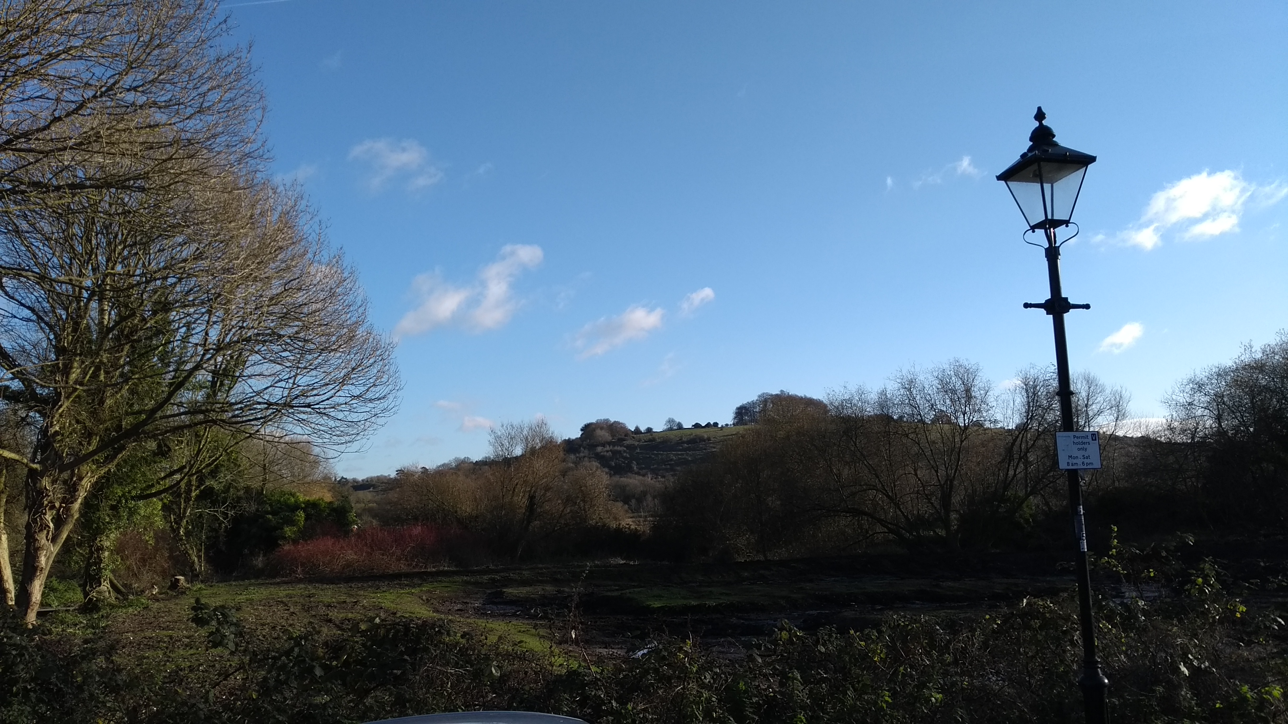

Slide 7
RE: Clausentum Fen 29 September 2017
Marcus I understand that this is a brilliant initiative by local residents supported by ourselves and Trust for Conservation Volunteers (TCV) to undertake some of the habitat management on Clausentum Fen. You have raised the funding to employ a contractor to undertake tree clearance and ground works which frankly we were unlikely to have the resources to do ourselves. However our Rangers are very supportive of the project. Again this is a great example of local community involvement in managing a very important green space. I will try to visit you at some point. Best wishes Andrew Cllr Andrew Gibson Executive Member - Culture, Recreation & Countryside Hampshire County Council

Slide 8
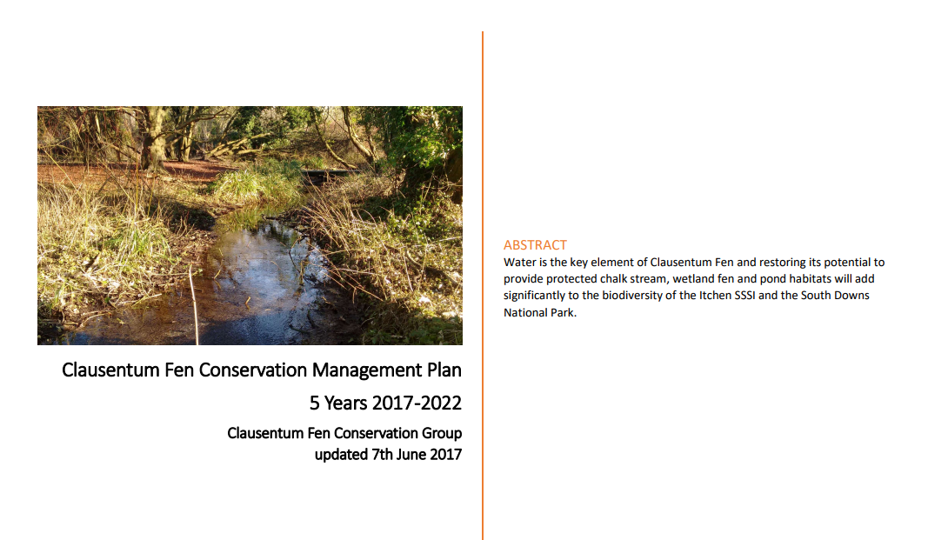
2017 Management Plan
Water is the key element of Clausentum Fen and restoring its potential to provide protected chalk stream, wetland fen and pond habitats will add significantly to the biodiversity of the Itchen SSSI and the South Downs National Park.
restore and conserve the different habitats to optimise biodiversity
enlist, engage and inform the community with our biodiversity programme
maintain community access via the recreation area and paths
upgrade Clausentum Fen to a Local Nature Reserve to secure long-term support and protection t to support desired species.

Slide 9
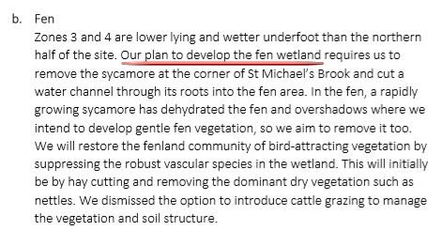

Slide 10
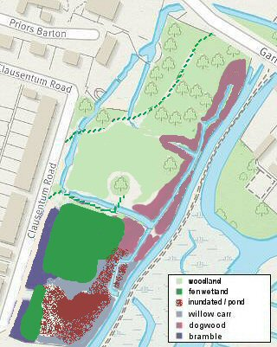
Map 2: Proposals for Management of Clausentum Fen
This chart shows our vision for 2022 biodiversity improvements:
- managed St Michael’s brook (west) for consistent flow, depth and light
- managed woodland but more open in zones 1 & 2 (reduced cypresses)
- managed protective scrub along the Floodstoc (east) drain
- rewetted fen in zone 3 by connecting to St Michael’s brook
- reduce dehydration of fen by removing sycamore and scrub
- retain highly biodiverse bramble patches in zones 3 & 4
- vegetated wet areas and still pond in zone 4
Remedial work will take some time, with priority given to stream and wetlands to enhance the value to wildlife.
The basis for SINC status should also be the basis for seeking LNR status. A mosaic of favoured biodiverse habitats alongside the River Itchen SSSI. Our plan also recognises access of the site by the community.
Z1
Z2

Slide 11
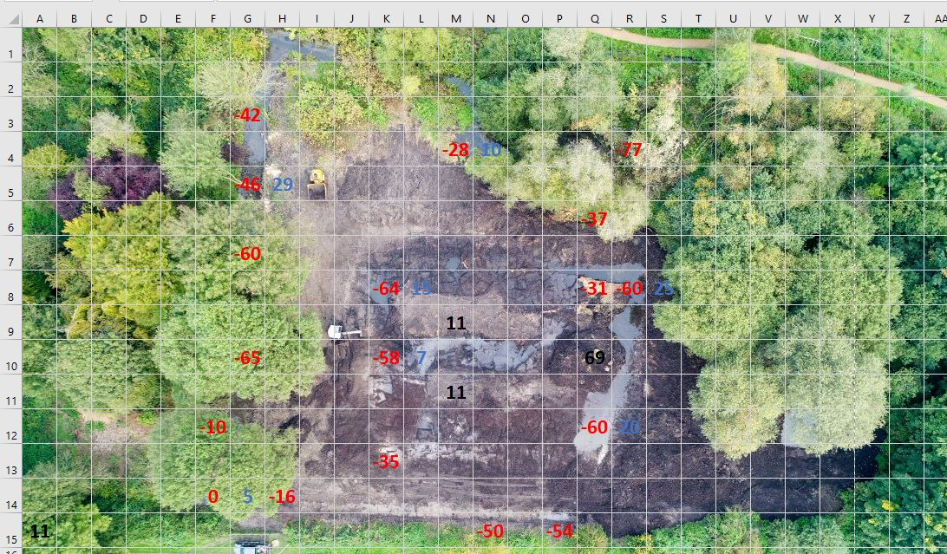
Scrub, root systems and excess peat removed
Wetland channel excavated to enable flow downhill gradient of 1% from brook
Water height in zone 3 is controlled by the exit sluice from the site
New channel / pipe will allow 20m³ per day of chalk stream water to flow across the fen – fresh and biodiverse
If goal water depth is 0.1m average, over 600m² the volume would be 60m³. So the refresh time is 3 days

Slide 12
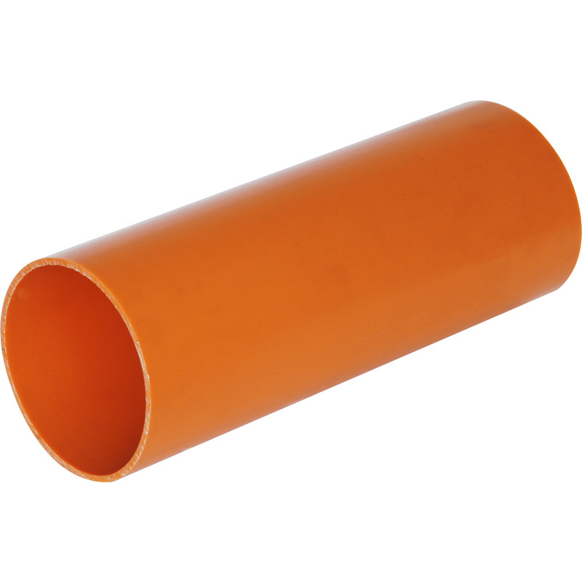
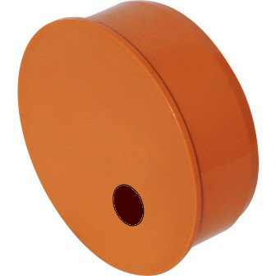
30m x 110mm pipe with 16.4mm diameter aperture gives 20,000 litres (20m3) water per day if head is 100mm

Slide 13
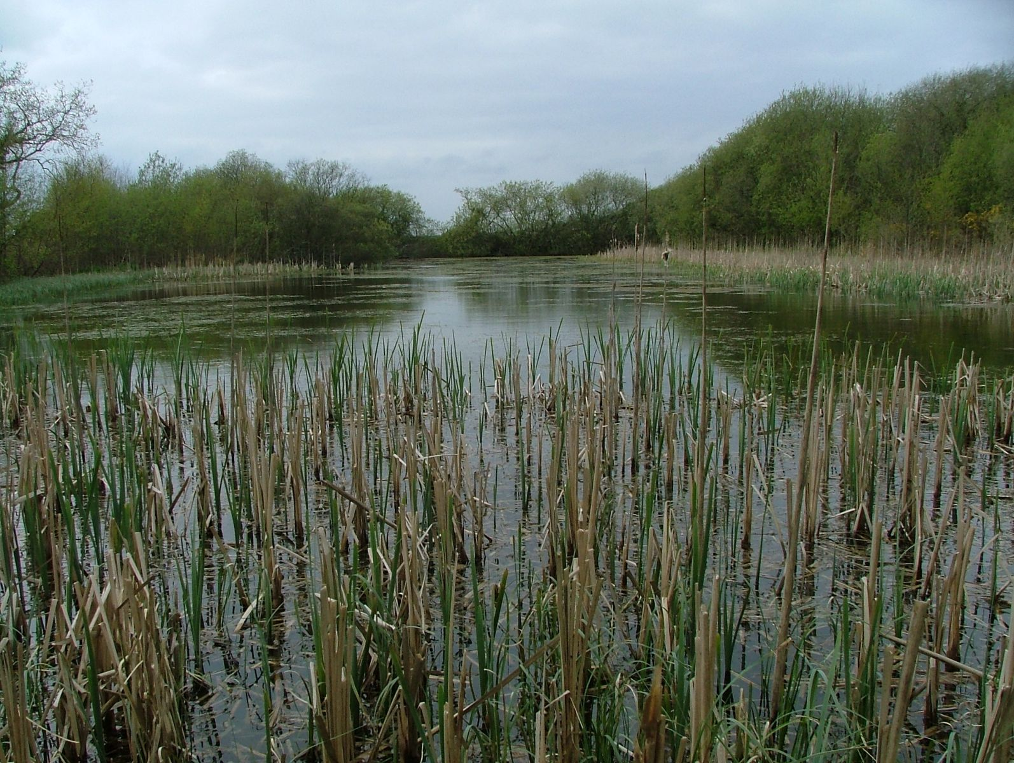
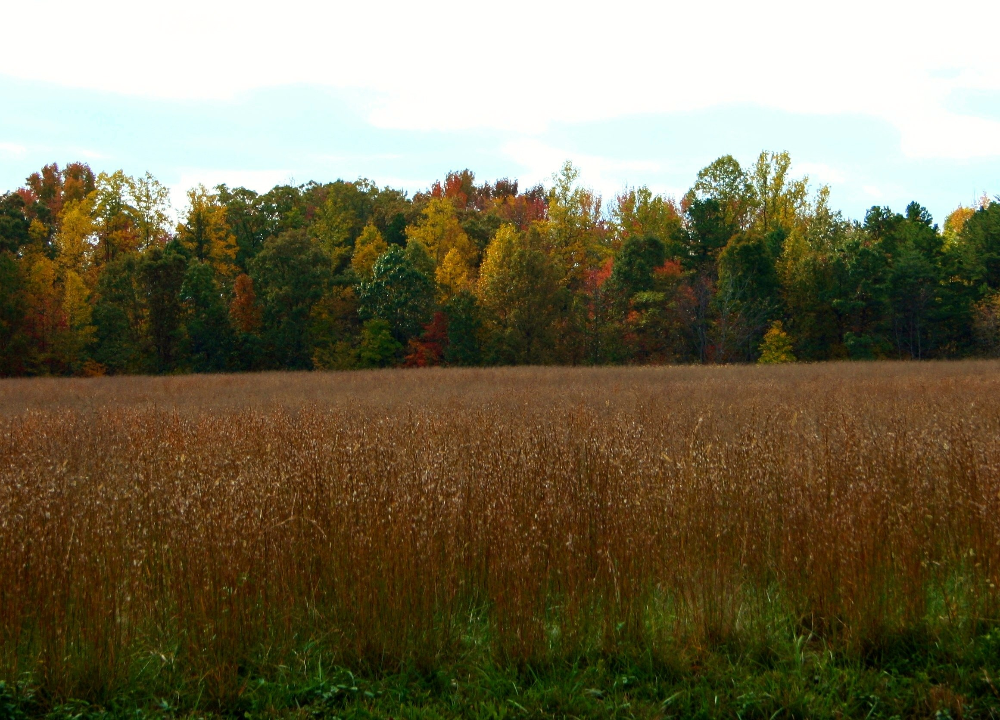
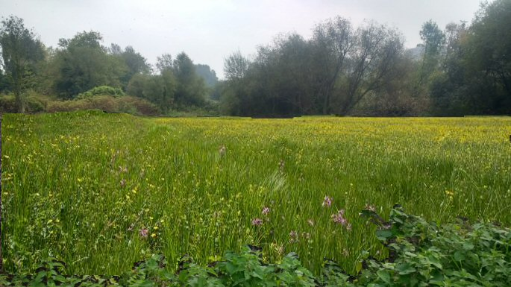
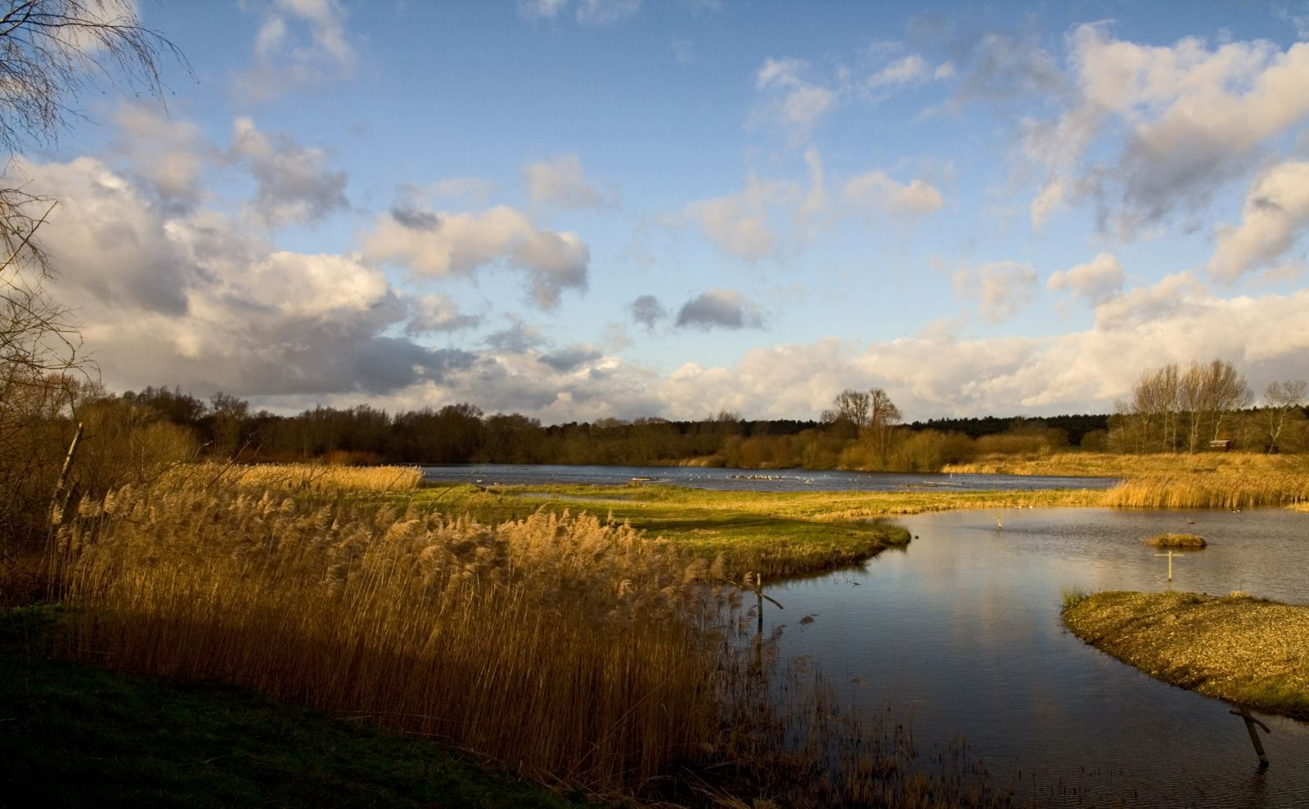

Slide 14
Our journey
Something has to be done!
Take on the responsibility to do it
Explore ways to approach the challenge
Communicate and network widely, taking in all ideas & opinions
Create a plan and coordinate activities from it
Resourceful – supply basic cash for resources, tools etc
Work hard – personal efforts
Motivate partners to help us and find funding
Keep everyone informed
Take the opportunities to maximise progress with minimal costs
Notes:
Who are the entrepreneurs?
Joseph Schumpeter described entrepreneurs as people who:
greatly value self-reliance
strive for distinction through excellence
are highly optimistic (otherwise nothing would be undertaken)
always favour challenges of medium risk (neither too easy, nor ruinous)
http://www.businessdictionary.com/definition/entrepreneur.html
Joseph Schumpeter born 1883 German, Czech, Austrian – Prof Harvard 1937 – died 1950 is the father of entrepreneurial theories

