Slide 1
CONSERVATION REPORT

Slide 2
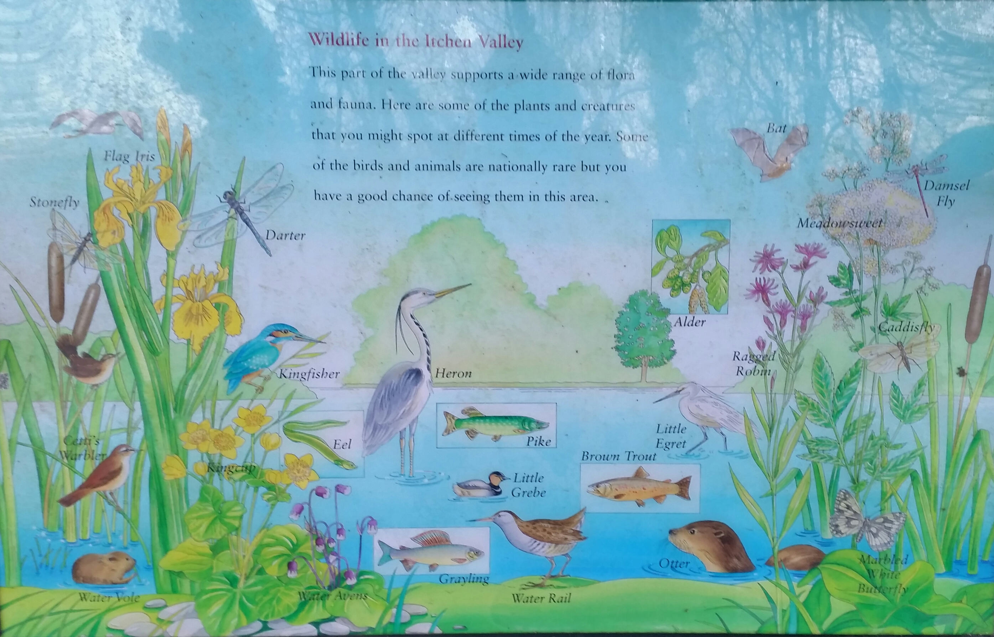

Slide 3
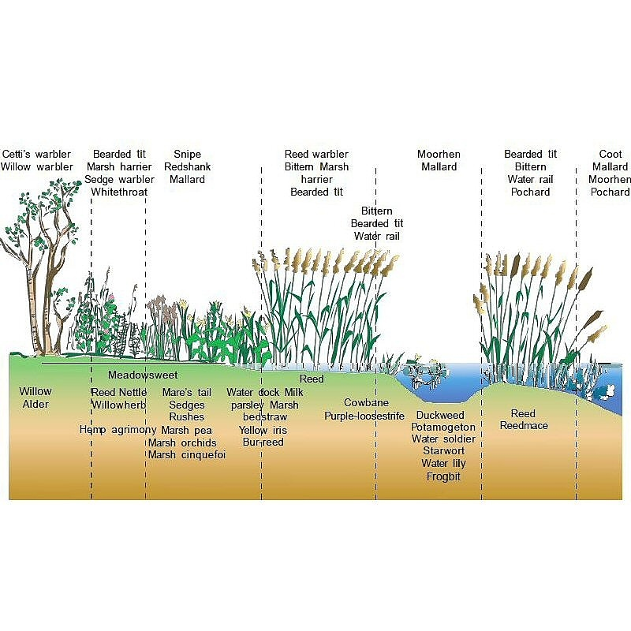
The wide variety of species found on fens are typically associated with different types and structure of vegetation, and different water levels
The Fen Management Handbook

Slide 4
Not just birds!
Aquatic plants in chalk stream, alkali pools, silt and groundwater pond
Riverfly and other insects
Fish, lampreys
Amphibia – frogs, toads, newts
Reptiles – slow worms
Mammals – deer, otter, fox, water voles, shrews, bats

Slide 5
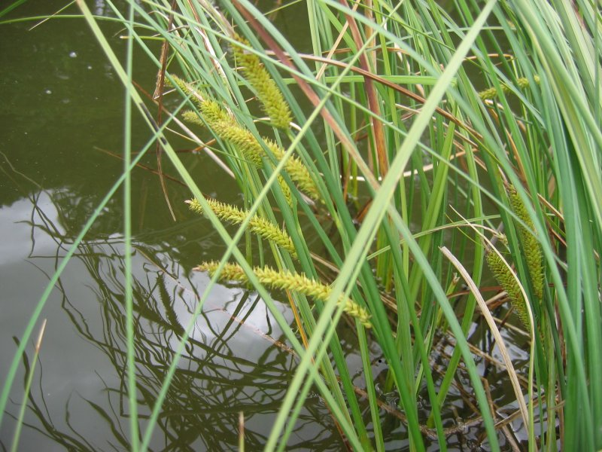
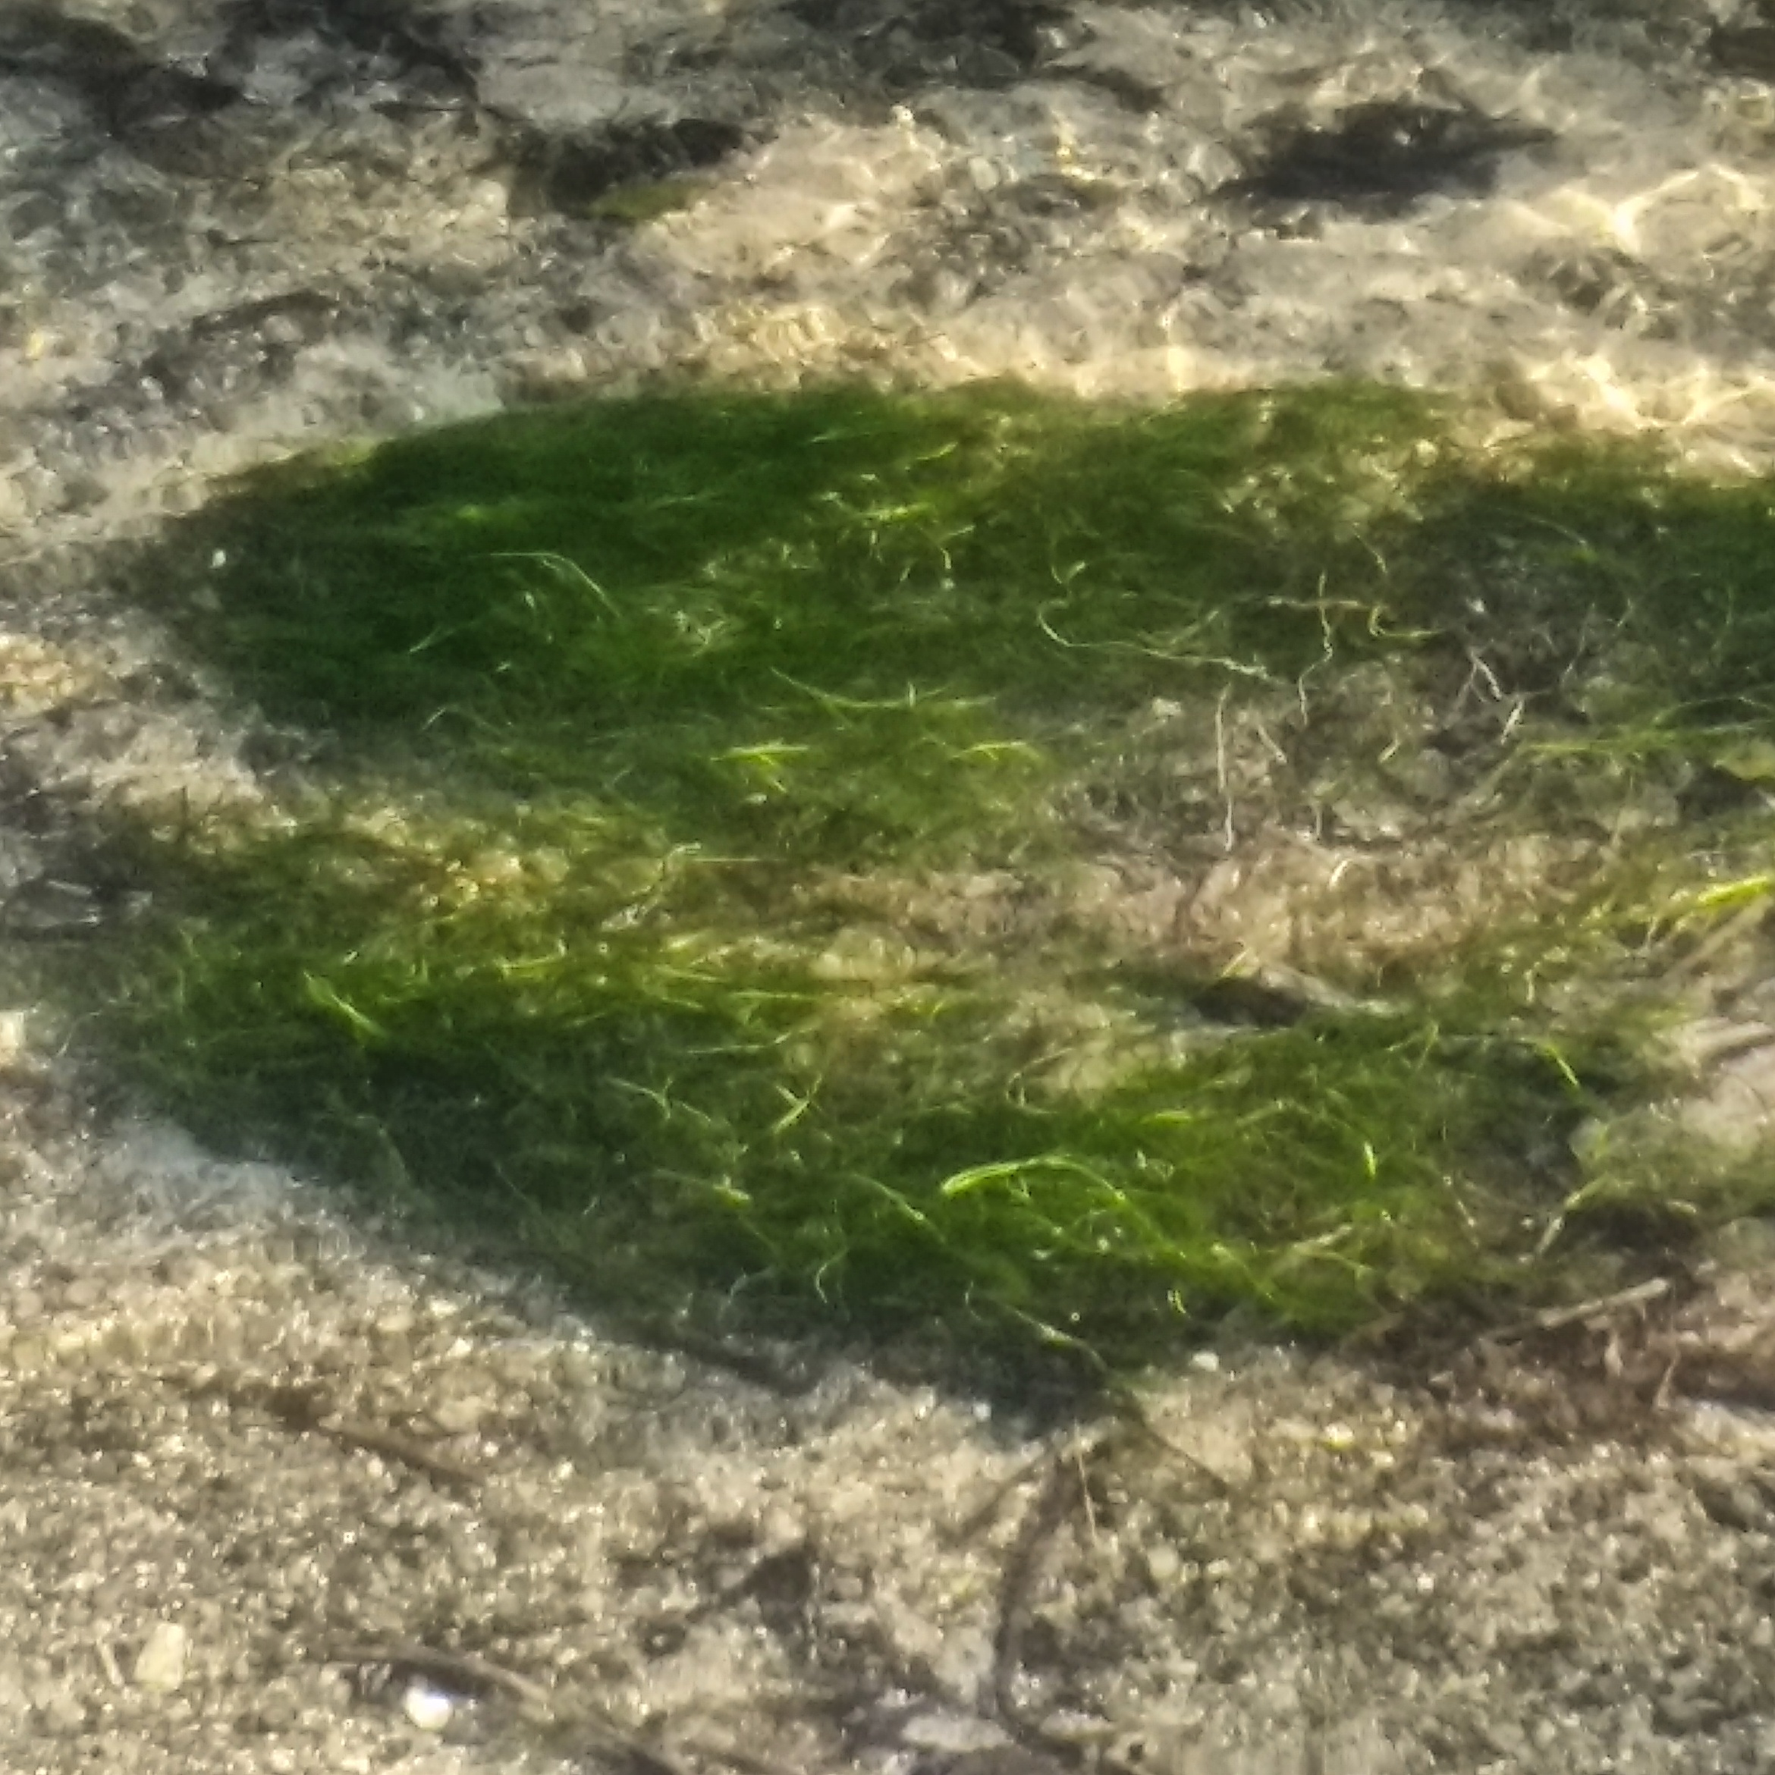
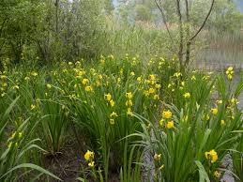
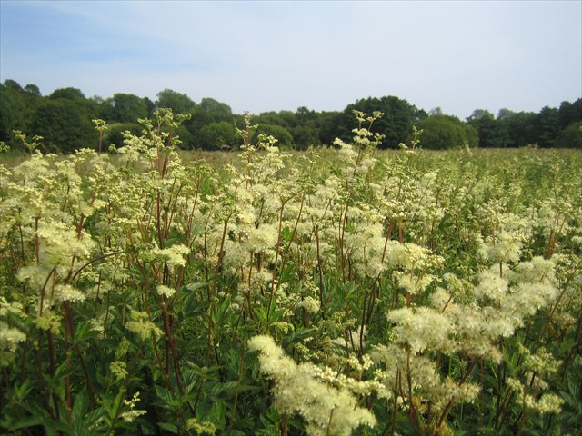

Slide 6
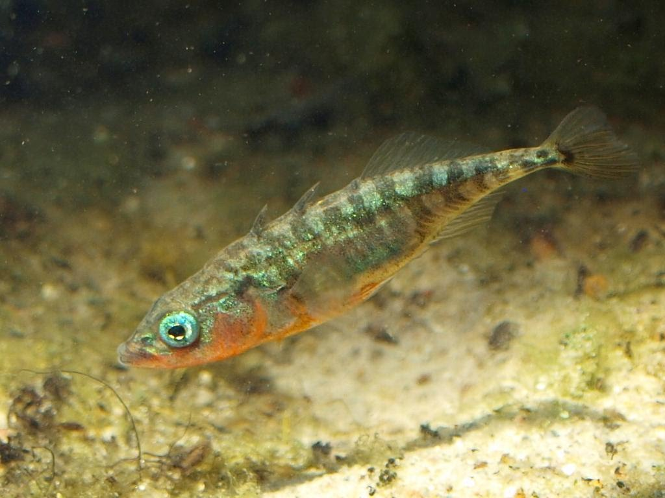
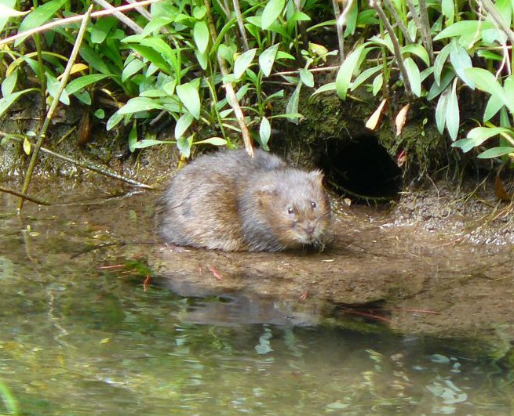
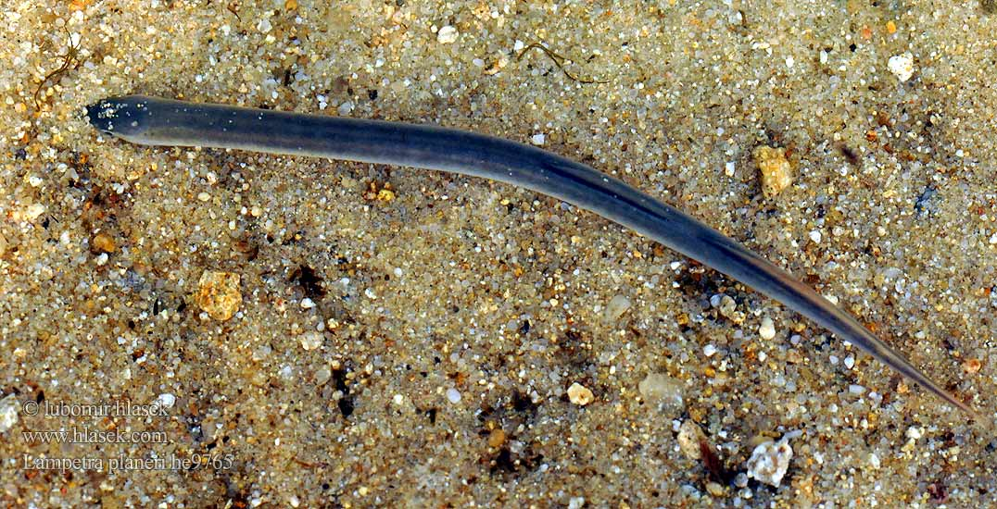
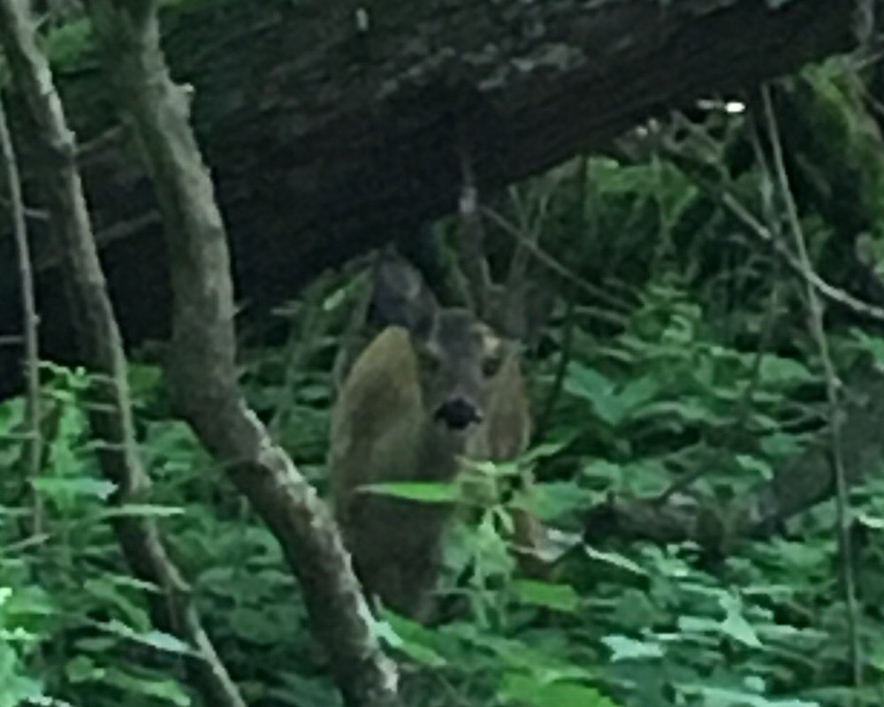
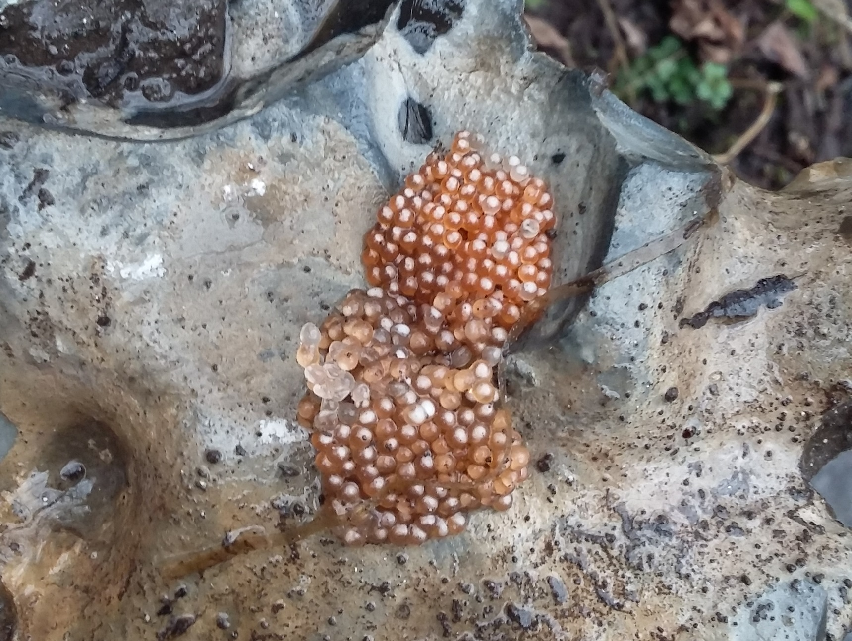
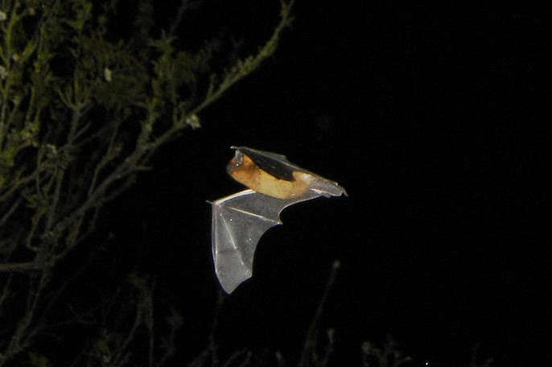
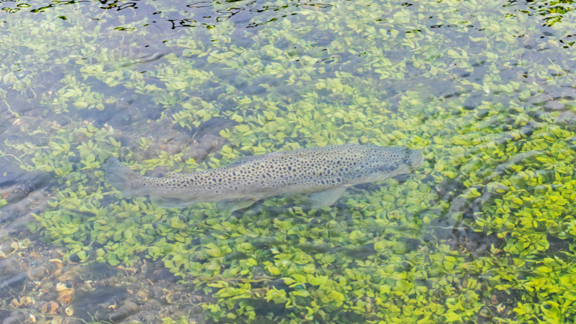
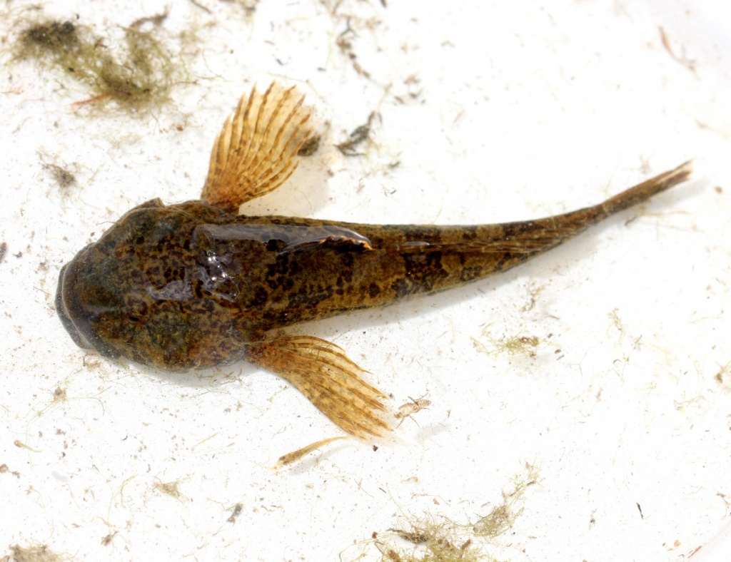
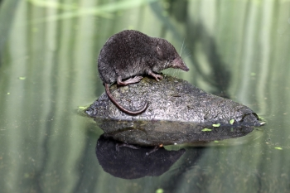
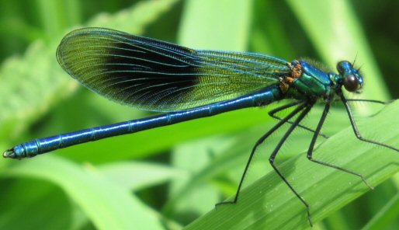

Slide 7
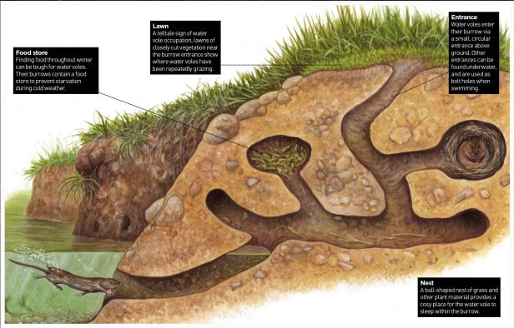

Slide 8
waders - snipe?
waders need a high Spring water table to keep their invertebrate prey near the surface
different waders require different height vegetation and water levels
e.g. snipe like to hide in tall vegetation and feed on soft damp soil and redshank like short swards, nesting in taller areas and feeding in shallow surface water
wildfowl - ducks, geese, swans
marsh fritillary butterflies are scarce and seek wet meadows with Devil's bit scabious plants
Dragonflies / damselflies
Riverflies
moths - bramble
bats - Daubenton bats fly close to water to find riverfly prey
otter
water voles

