Slide 1
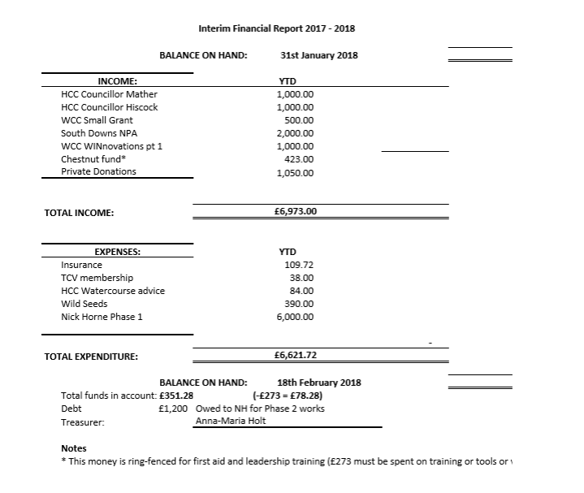
INTERIM FINANCIAL REPORT 2017/2018

Slide 2
ClausentUM Fen Conservation Group
Survey monkey results 2018
Notes:
28 respondents

Slide 3
There has been a significant amount of work on the Fen in the last year. Please comment on any specific views you have on work undertaken to date.
“Generally very good in clearing non-native species. Looks a bit barren at the moment but plans look great”
“We were deeply saddened by the sheer devastation of the fen from what was a green and lush area. This was not in the original plan.”
Notes:
See comments document. Mixed responses ranging from positive and supportive to critical/unsupportive.
You will notice that there were multiple entries from the same home/IP address, which have been marked.

Slide 4
We have drafted a Plan for 2018 (attached to AGM notice email/letter) and would like your views. Please comment on any aspects of concern, in support or ideas that you would like to see included.
Plan looks fine, less ambitious than 2017. Concern would be reliance on community. Is it not possible to get the local government to support on maintenance given they have a commitment to do this? Cannot see from the plan if there is further seeding planned, but would hope to see some re-growth this year to try and improve the appearance of the fen
Fine tuning excavations in Zone 3. Too wide? Re-wetting or flowing water? Expense of joining to St. M Brook - sLuice etc? Query amount of management required anD by whom?
The plan looks excellent. Happy to contribute where required to achieve

Slide 5
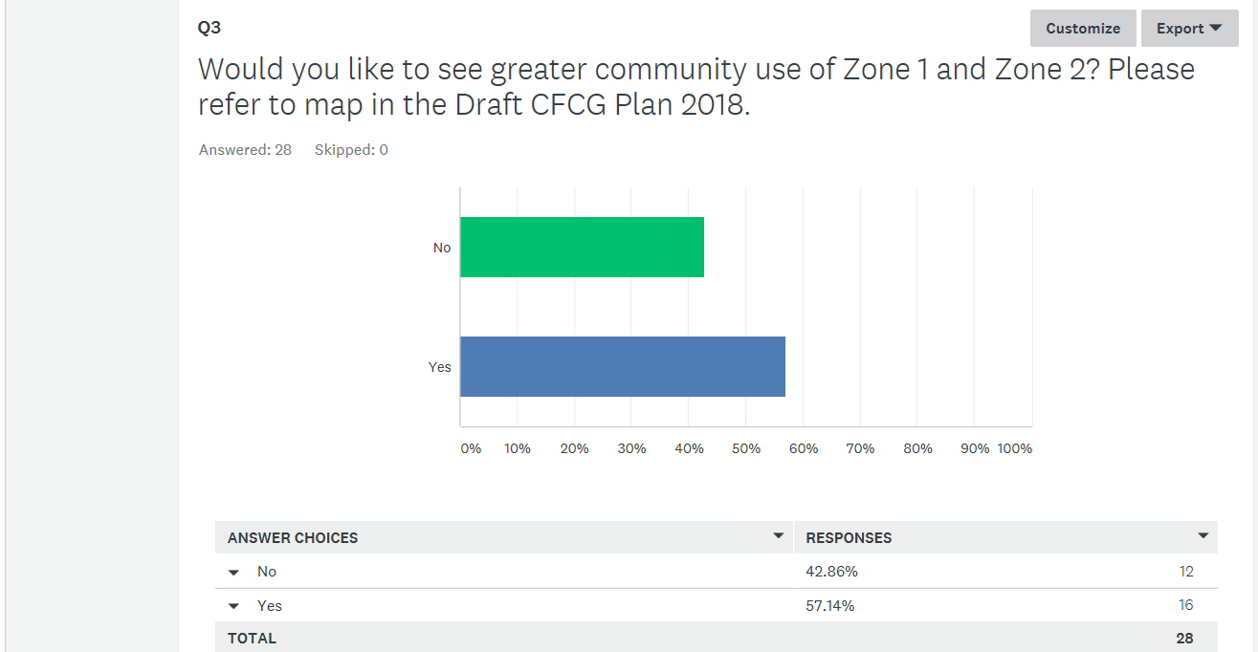

Slide 6
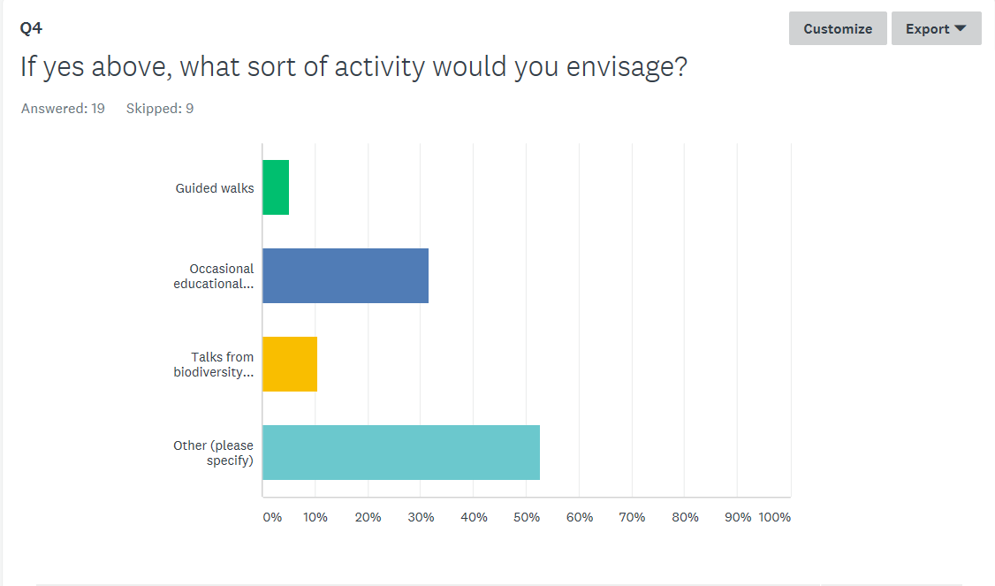
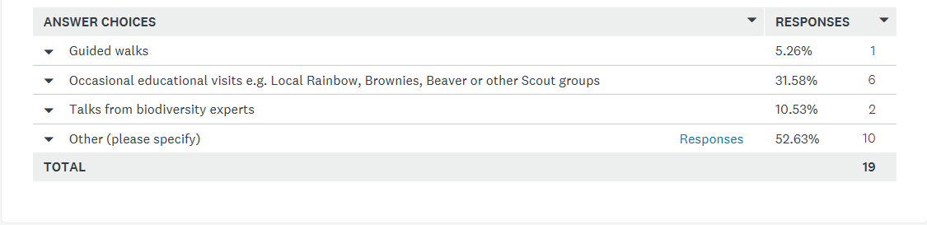

Slide 7
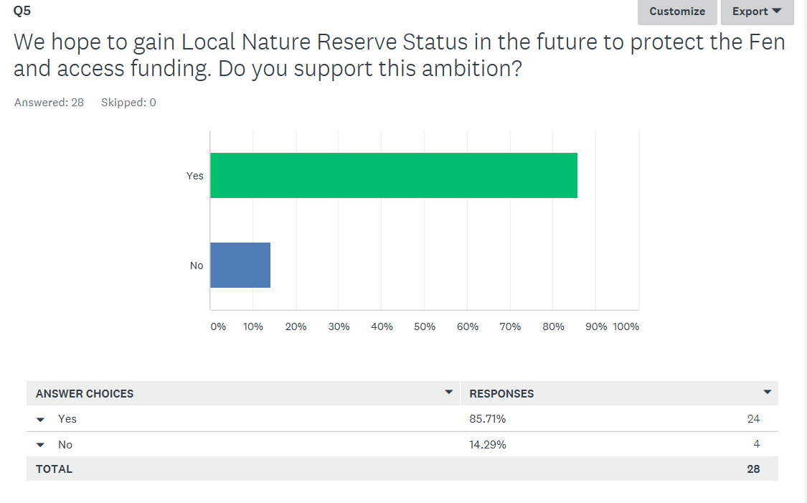

Slide 8
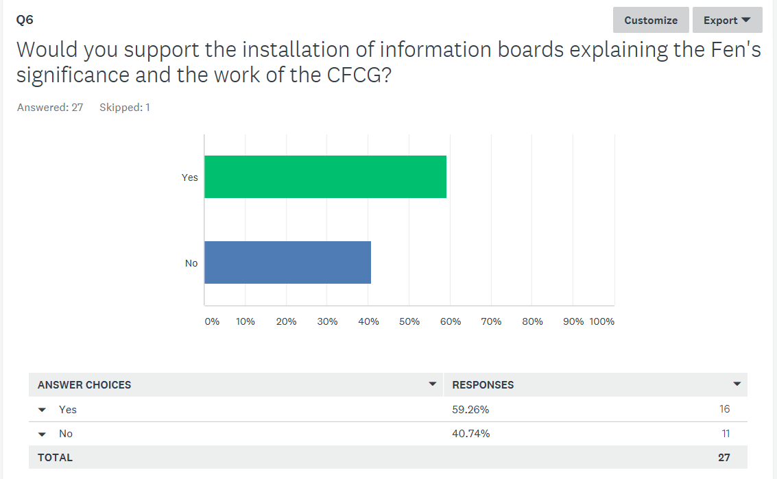

Slide 9
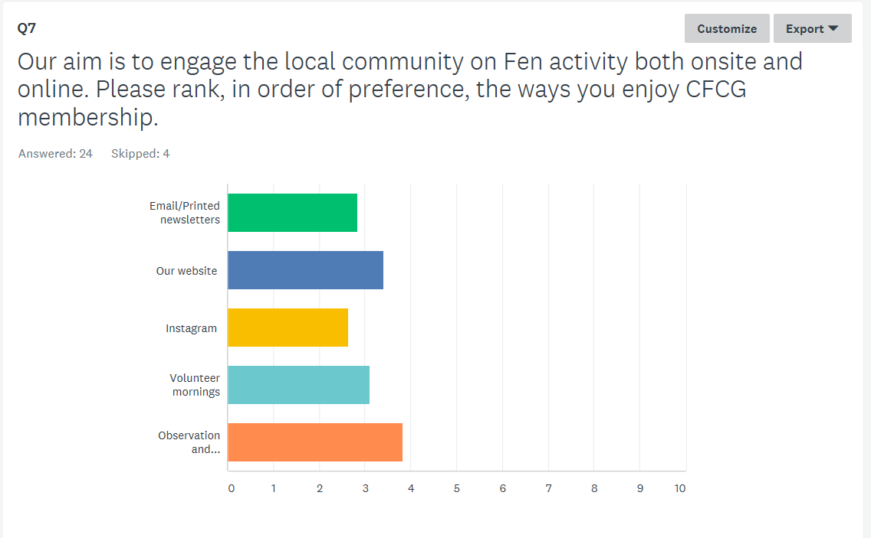
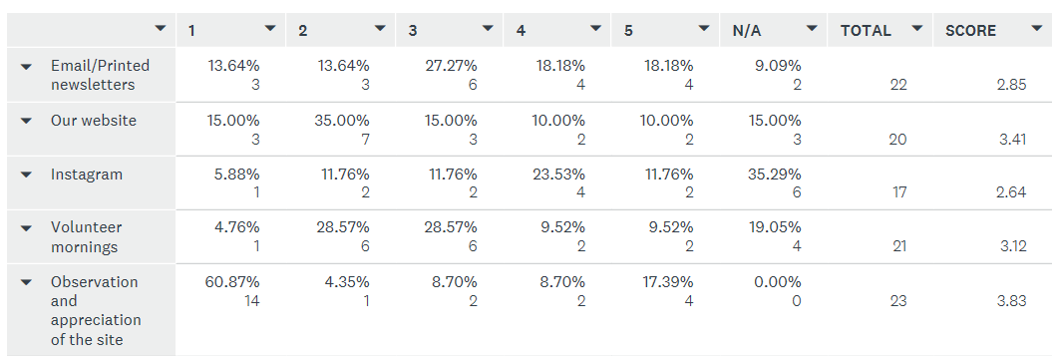

Slide 10
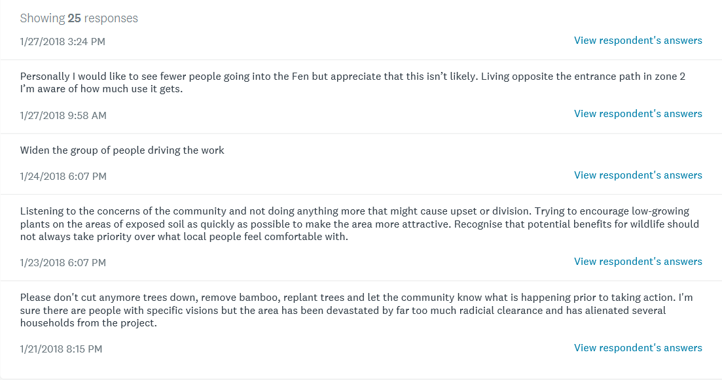
What do you think we could improve on in 2018? Please add any other comments.

Slide 11
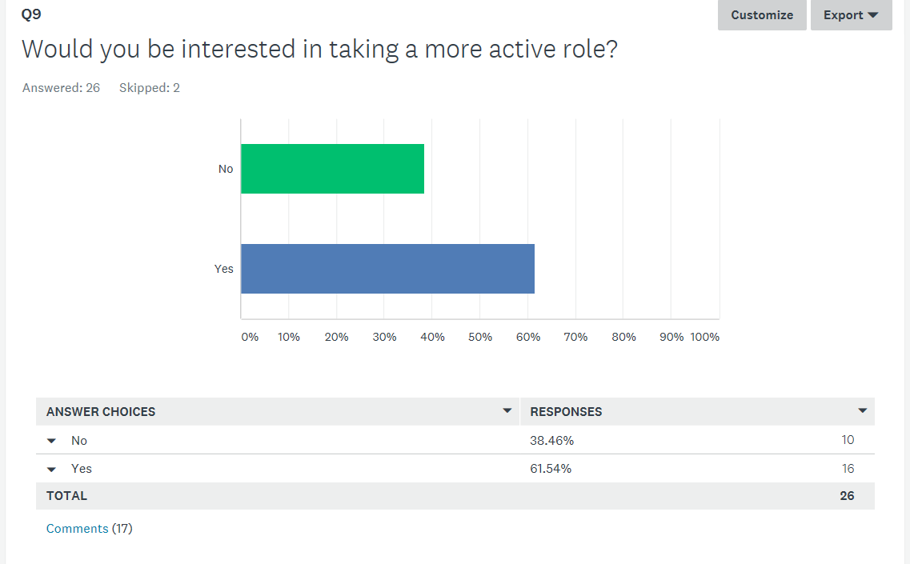
Notes:
Showing 17 responses
Volunteering and possibly financially for work on the bund
2/10/2018 7:40 PM View respondent's answers
Practical help only if plans are more openly discussed & I agree with them.
2/5/2018 6:26 PM View respondent's answers
Digging, site research, potentially funding.
2/2/2018 7:25 PM View respondent's answers
Practical help
2/2/2018 12:19 PM View respondent's answers
Subject to commitments
2/2/2018 11:45 AM View respondent's answers
more locals on the committee
Gaining a better understanding and offering more time.
1/29/2018 1:57 PM View respondent's answers
Digging and planting
1/27/2018 3:24 PM View respondent's answers
I am already actively involved
1/24/2018 6:07 PM View respondent's answers
volunteering
1/23/2018 6:07 PM View respondent's answers
Contribute to management of the Fen and protection of biodiversity
1/19/2018 9:19 PM View respondent's answers
I would volunteer, and be very willing to attend more consultation meetings.Perhaps committeee meetings could sometimes be open so members could know what was happening.
1/19/2018 8:28 PM View respondent's answers
Contribute to management of the Fen and protection of biodiversity
1/19/2018 7:46 PM View respondent's answers
Happy to volunteer - not necessarily on a fixed day of the week
1/19/2018 7:24 PM View respondent's answers
Working party
1/19/2018 11:12 AM View respondent's answers
When time allows, certainly I would help, maybe lighter evenings and some weekends when there is free time?
1/18/2018 3:07 PM View respondent's answers
gentle volunteering in well organised sessions

Slide 12
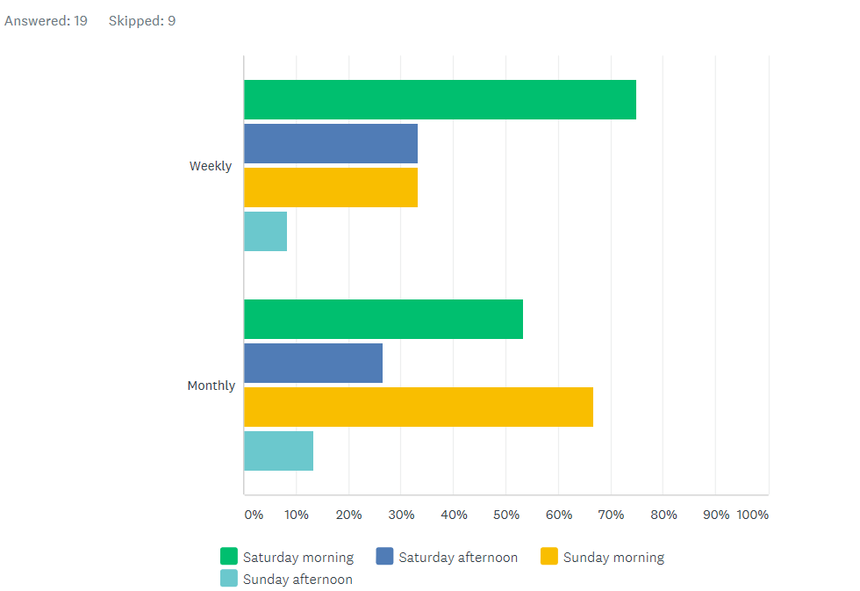
We would like to involve as many members as possible on regular working parties on the Fen. Please select when would suit you best.
Notes:
Am concerned that consideration must be given to keeping management needed to a minimum for the future.
2/10/2018 7:40 PM View respondent's answers
2/2/2018 7:25 PM View respondent's answers
weekdays
1/31/2018 5:17 PM View respondent's answers
I can not commit to further involvement so haven't selected. If I did then I would go for a programme with times that vary during the year with monthly events
Sunday morning not good for those who go to Church.
1/23/2018 6:07 PM

